Slide 1
Arduino Workshop #1
These workshop are based on the book Exploring Arduino by Jeremey Blum. $15.75 on Amazon.
Notes:
24 Arduino Uno
24 USB cable

Slide 2
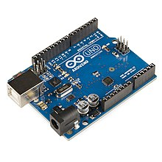
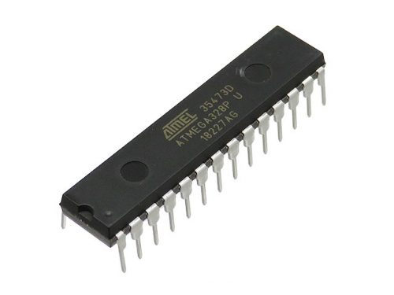
What is an Arduino
The Arduino is an entry level Micro-controller
The IC (Integrated Circuit)chip is the microcontroller.
It sits on a development board so you can easily attach sensors and other devices to it.
Chips come in different packages.
We will use the Arduino Uno R3 with the 28 pin DIP (Dual Inline Package) package.
The chip is actually called the Atmel ATMEGA 328P-PU. Data Sheet Here.

Slide 3
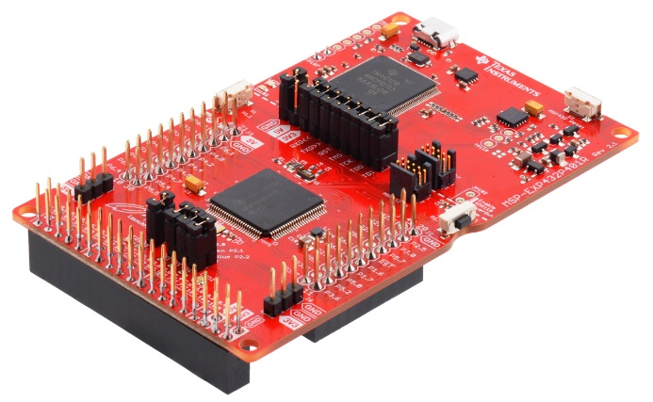
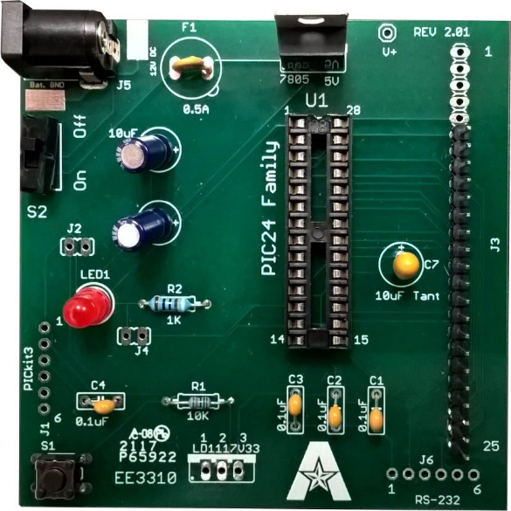
Other Micro Controllers
Other microcontrollers you will see during your EE education are
Texas instruments MSP-430/432.
MicroChip PIC16
All chips have different models to accommodate what your design needs are.
Number of input/output pins, package ( Size ), processor speed?
Built in Wifi or Bluetooth needed?

Slide 4
Let’s get started already
You will need the Arduino Uno R3 microcontroller and a USB cable for this first workshop.
You will need to download the Arduino programming software also. Go to https://www.arduino.cc/en/software and download the Win7 or newer version and install it.
Open the Arduino Program.

Slide 5
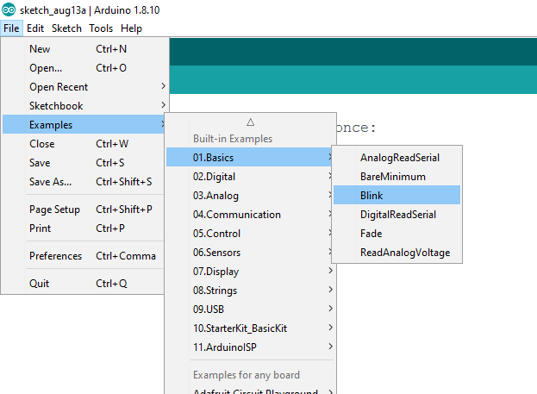
Examples
Let’s load a program to blink the on-board LED.
File-> Examples -> 01.Basics -> Blink

Slide 6
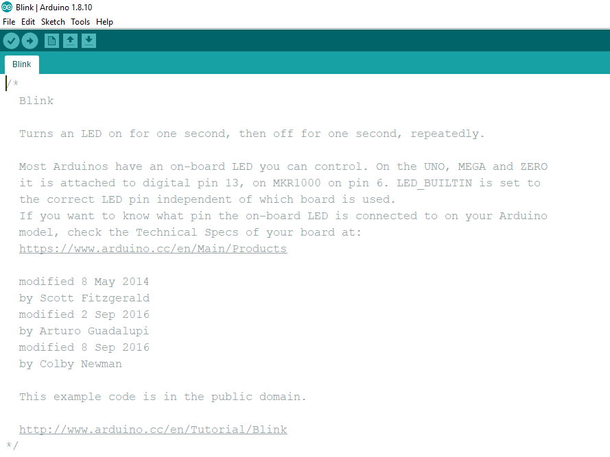
Header
The header “ Comments” at the top of the program explains that pin 13 of the ATMEGA328 has a LED attached to it on the development board (The Uno).
Notice the text is in between /* and */. This lets you use comments just like in the C programming language. Always write comments so you can remember what does what. It can get very complicated!

Slide 7
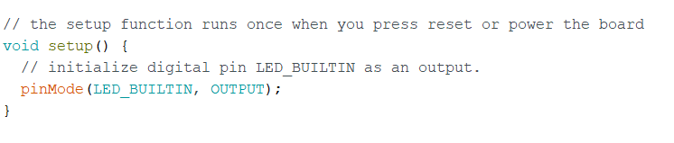
Set up
The setup function always goes first.
The void before the setup just means this function does not return any values
The keyword pinMode let you set the pin to an output or and input.
LED_BUILTIN is defined already as pin 13. You could also just write 13 here.
Enter this into the program.
Notes:
The void in front of set up means we don’t have to give the function any data to make it work. Functions are defined by the ()

Slide 8
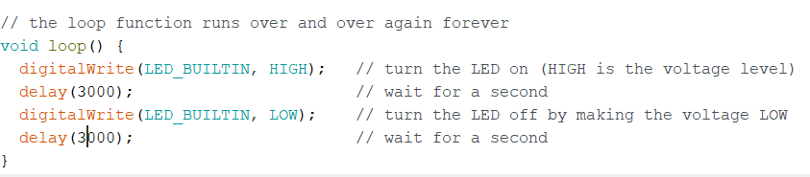
Loop
The loop function must be present.
It loops.
Enter this into your program.
Delay(3000) will delay the program 3000ms or 3 seconds. This blinks the LED off and on every 3 seconds.

Slide 9
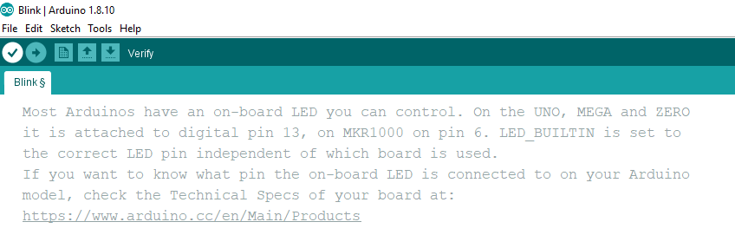
Error checking your code
Click the check to verify your code is correct.

Slide 10
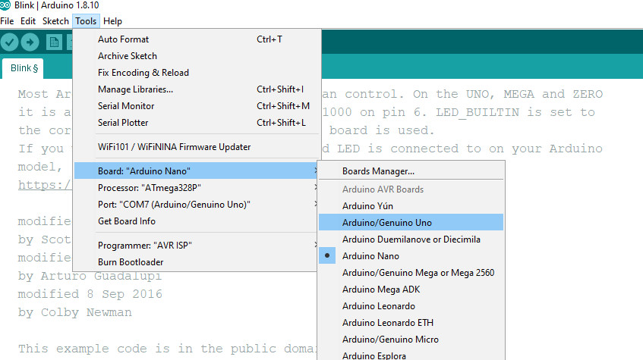
Connect
Plug in your Arduino with the USB cable.
Select Tools -> Board:”Current board” -> Arduino/Genuino Uno

Slide 11
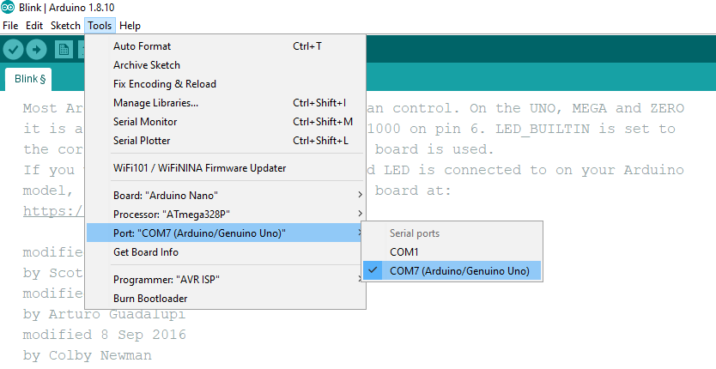
Com Port
Select – Tools -> Port:”Current port” -> Com port your Arduino was assigned by the computer. Mine was on Com 7.
Let me know if you can’t connect.

Slide 12
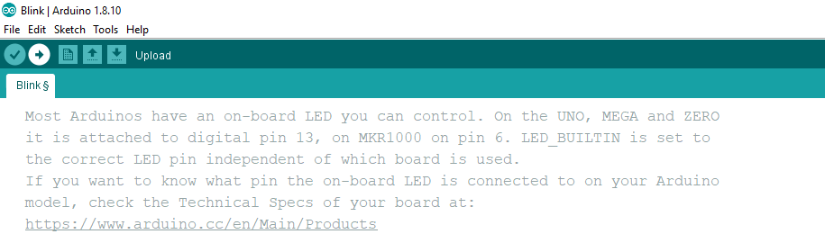
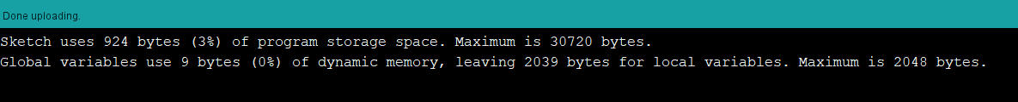
Final step
Click the “Upload” Right arrow to send your code into the ATMEGA328.
The terminal window should show done uploading.
Change the delay time and upload again.
How fast can you blink the LED until it looks like it’s always on.
Some experts will tell you that the human eye can see between 30 and 60 frames per second. Some maintain that it's not really possible for the human eye to perceive more than 60 frames per second.

